Slide 1
Risk-based labour inspection by means of machine learning
Øyvind Dahl, SINTEF
Notes:
Bildet illustrerer:
· bredden i SINTEFs ekspertise, fra havrom til verdensrom.
· hvilke områder og bransjer vi jobber innen for å realisere visjonen Teknologi for et bedre samfunn.
Bildestilen er basert på stikkordene fremtidsrettet, teknologi og norsk natur (naturressurser). SINTEFs visuelle univers er utviklet for SINTEF av Headspin Productions AS.

Slide 2
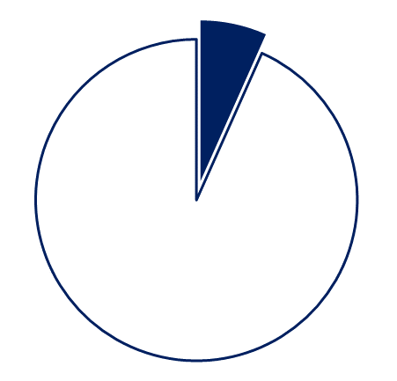
Background
Norwegian Labour Inspection Authority (NLIA)
Selecting objects (enterprises) for inspection is a fundamental part of the inspection process
The selection shall be risk-based
I.e. select objects on basis of where the assumed risk is highest (injuries, harmful exp. etc)
The NLIA has 230.000 potential objects for inspection
15.000 inspections per year
How can the NLIA identify the high-risk enterprises?

Slide 3
The challenge
Develop a tool which can function as an aid to the inspectors' selection of object for inspection
The tool must be capable of differentiating between different groups of enterprises, based on risk

Slide 4
Operationalizing the challenge
The model behind the tool must be based on available data that are not biased in any way
Risk was defined as non-compliance with legal requirements
Thus enterprises with the highest risk will have more regulatory breaches per checkpoint than enterprises with the lowest risk

Slide 5
Operationalizing the challenge
Utilized structured data collected during inspections (N≈ 40,000)
Non-compliance was operationalized as follows:
≥ median value with regard to number of regulatory breaches per checkpoint
and/or
≥ 1 shutdown of operation, and/or
≥ 1 coercive fine, and/or
≥ 1 penalty, and/or
≥ 1 report to the police
Inspections with these characteristics were coded 1, else 0

Slide 6
Operationalized research question
Roughly 45% of the enterprises were assigned value 1
Is it possible to predict, with a low margin of error, which enterprises that belong to group 1?
This means: do enterprises which belong to group 1 have specific characteristics?
To test this we used logistic regression analysis
If the results of the analysis shows that it is possible to predict which enterprises that belong to group 1, then the model can be used to tell inspectors which enterprises they should prioritize by generalizing the results to all 230.000 enterprises

Slide 7
Logistic regression analysis
Characteristics (predictors)
Inspection results
Type of industry
Number of employees
Age of enterprise
Notifications of illness
Safety and Health Complaints
Accidents
VAT register
Employee register
Results previous inspections
Economic variables
Etc.
1
100%
Probability
0%
0

Slide 8
Logistic regression analysis
Inspection results
1
Highest probability of non-compliance (15%)
100%
High probability of non-compliance (35%)
Probability
Low probability of non-compliance (35%)
0%
Lowest probability of non-compliance (15%)
0

Slide 9
Assessing predictive validity
Does the model predict correct?
Prediction
% correct
Low compliance
91%
Low compliance
69%
High compliance
46%
High compliance
75%

Slide 10
Assessing predictive validity
Inspections: are there any differences between the groups?
Breaches per checkpoint

Slide 11
Assessing predictive validity
Inspections: are there any differences between the groups?
Formal orders per checkpoint

Slide 12
Assessing predictive validity
Inspections: are there any differences between the groups?
Coercive fines per inspection

Slide 13
Assessing predictive validity
Inspections: are there any differences between the groups?
Shutdown of operations

Slide 14
Conclusion
In addition to assessing predictive validity (ANOVA), other tests were run as well. E.g. Hosmer-Lemeshov, area under curve (AUC)
Conclusion 1: all tests indicate high predictive validity and high model fit
40,000 ---> 230,000

Slide 15
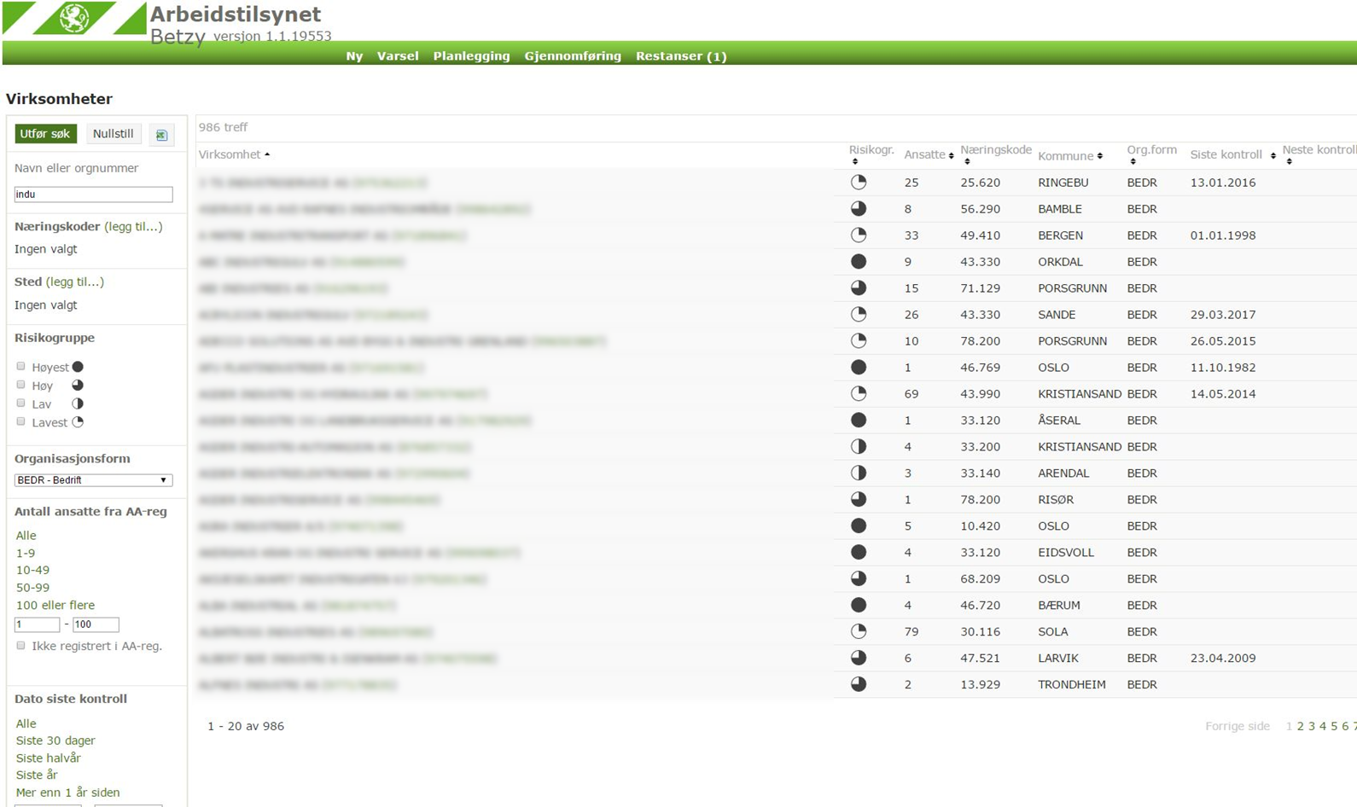

Slide 16
